Slide 1
Euforia
A Female-Oriented Gaming Community
Lost Stars
Jinyue Feng, Xingyue Dai, Siqi Yang, Fukun Li, Xinze Zhao

Slide 2
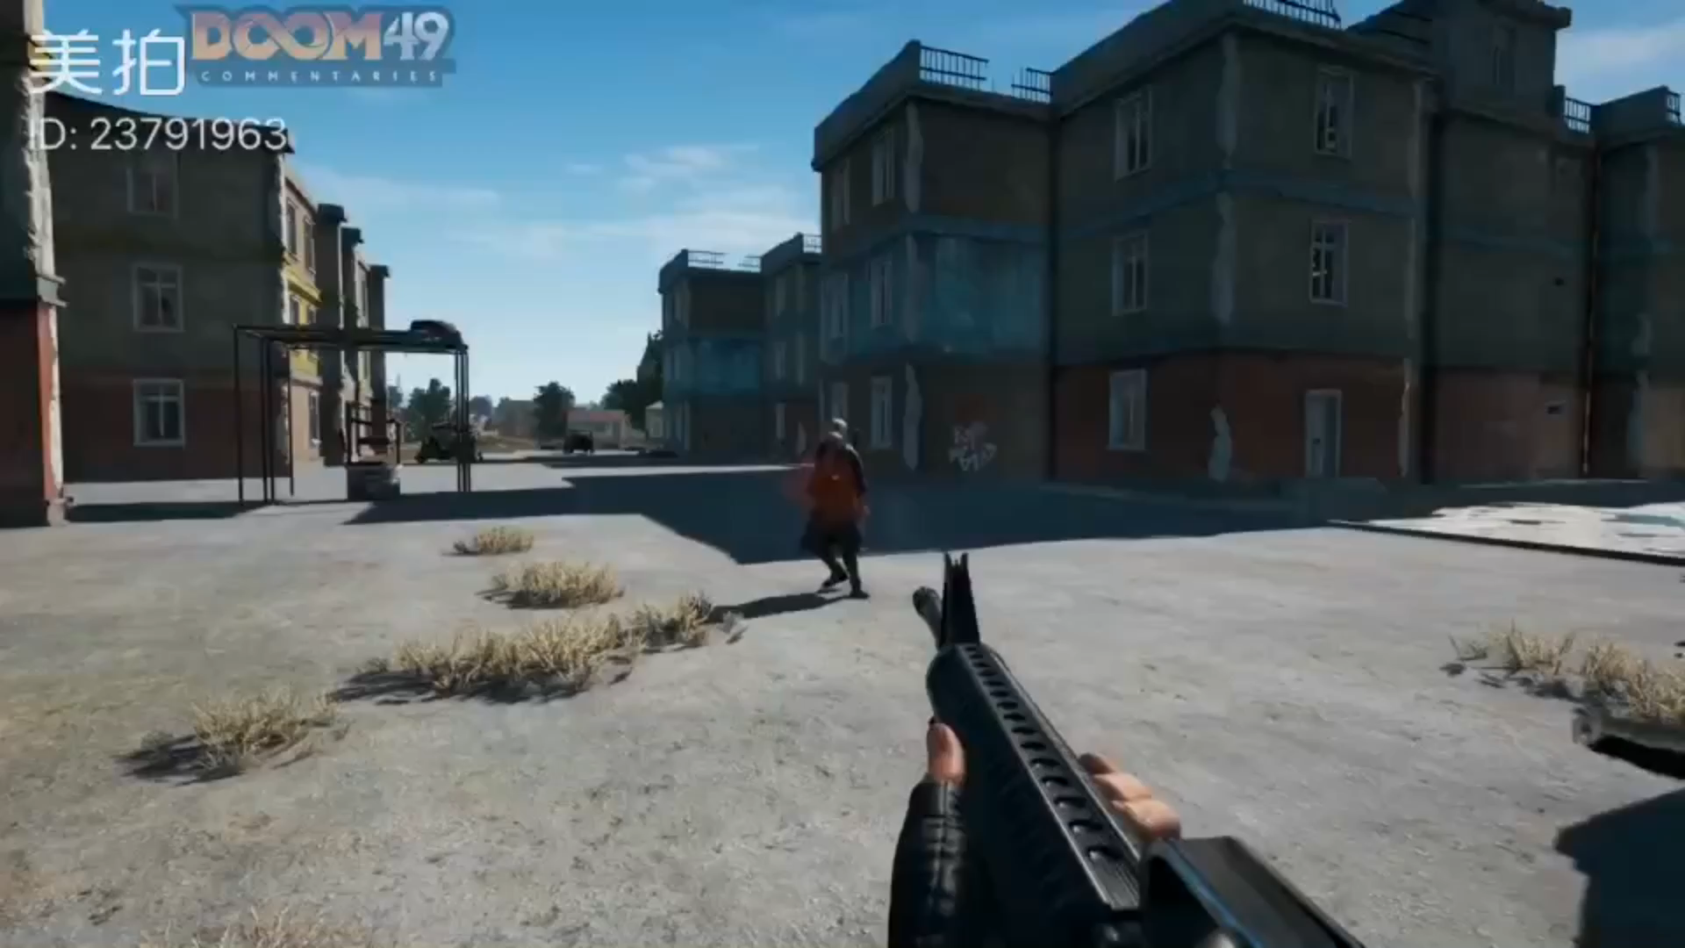

Slide 3
Problem Space
Gender Inequality in the Gaming World
Gender-based Harassment
Stereotype Threats
Stigmatization
Secondary Status
Objectifying Portrait
Lack of Females in the Gaming Industry
Male-targeting Advertisements
……

Slide 4
We Have A Dream
More girls will be interested in this exciting field which has so many potentials besides entertainment
Females will not find it necessary to hide their gender
Gender-based stereotypes will no longer be a threat
Female gamers will feel supported and welcomed

Slide 5
Our Final Product

Slide 6
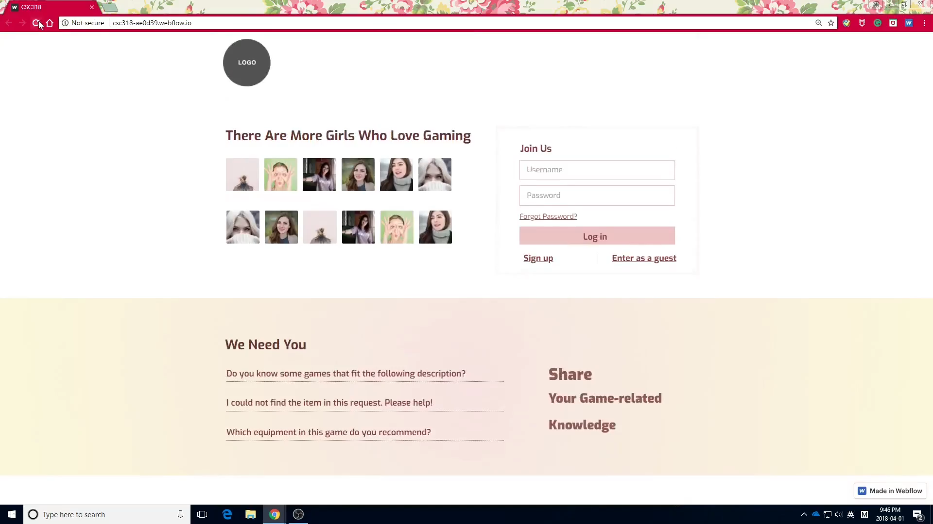

Slide 7
Usability Test Results

Slide 8
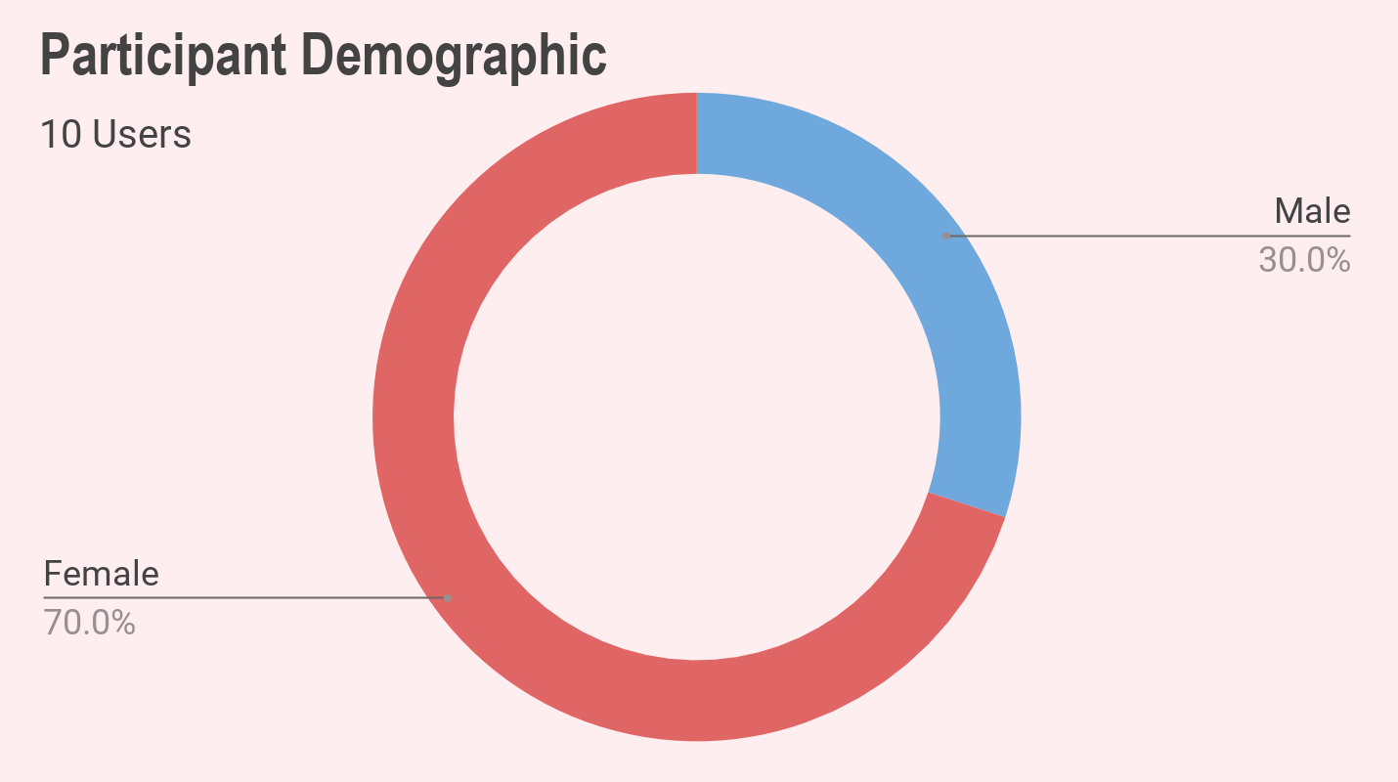
Function Usability Test Results
Usability Problems
 | Success Rate* | Average Time (sec) | Expected Time (sec)**
Find Games | 100% | 58.6 | 90
Team Up | 90% | 66.2 | 80
Seek help | 90% | 64.1 | 100
Game Lovers
Young Adults
User Impressions
Friendly(2) Easy(2) Nice/Good(2) Fun(1) Convenient(1) Exploration(1)
Difficulty to locate functions
User expectation vs our design logic
Buttons not visible enough
Notes:
Our participants were mostly females. They were young adults who enjoyed gaming.

Slide 9
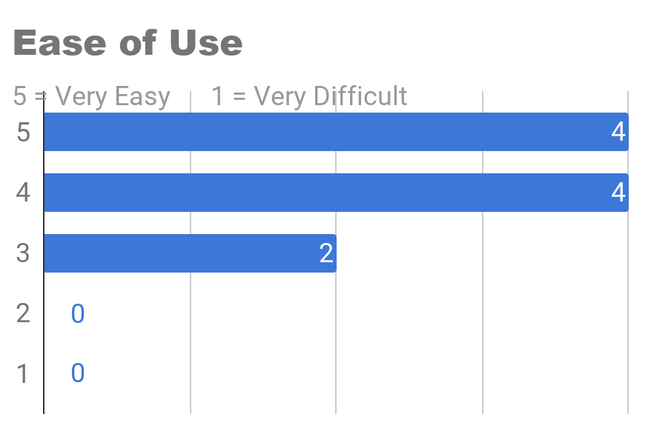
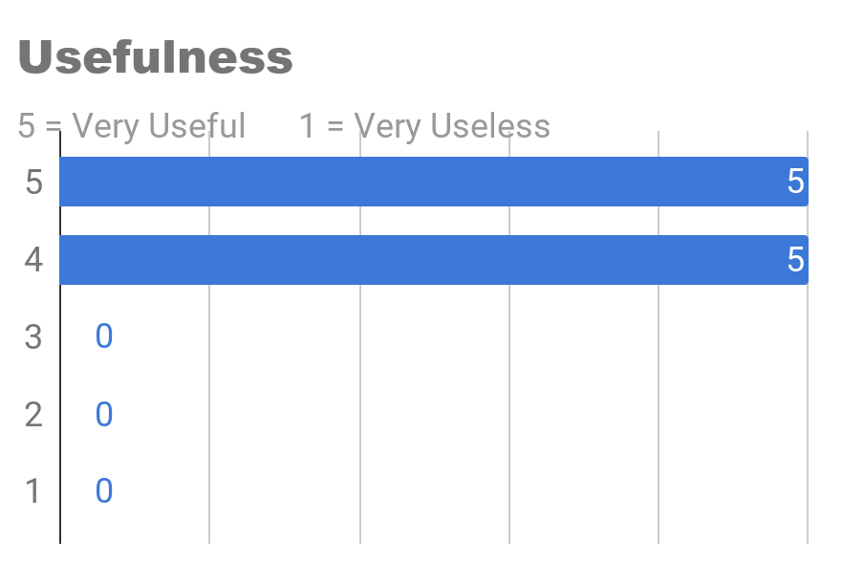
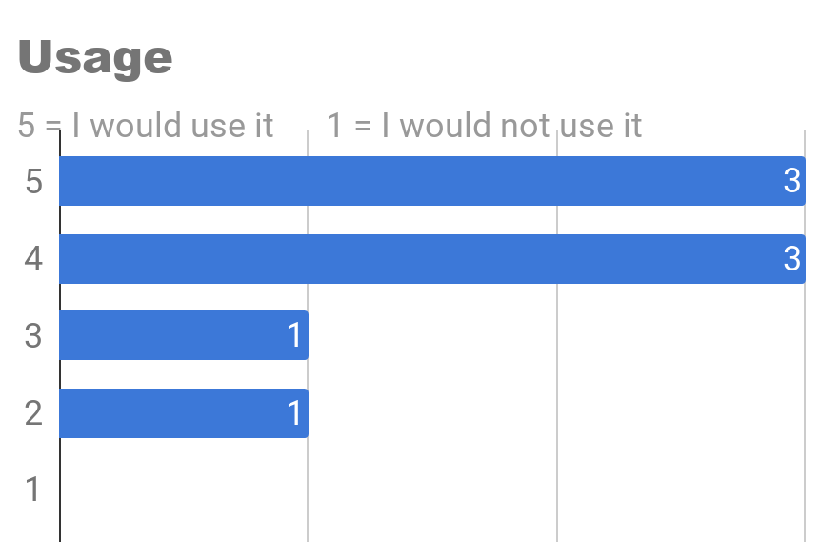
System Rating
Ease of Use: 4.2/5
Usefulness: 4.5/5
Usage (By Females): 4/5
(Male users indicated they will recommend this website to their female friends)
Notes:
To conclude the study, we would like to share some ratings with you. The scores were not bad.

Slide 10
Advantages
What our users think

Slide 11
Warm and Joyful Style
Soothing and welcoming colours
Soft Yellow + Light Pink + Warm Brown
Cheerful messages
Guiding messages
Encouraging users to share and support
Creating a game-like adventurous feel
Notes:
The style of our website is warm and joyful. We incorporated soothing colours and cheerful messages to encourage sharing and supporting. The section titles like Quest has a game-like feel.

Slide 12
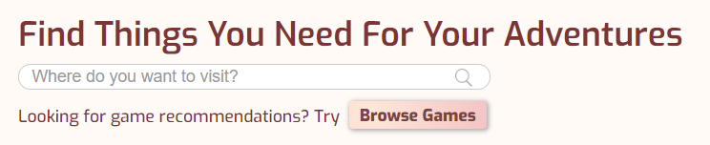
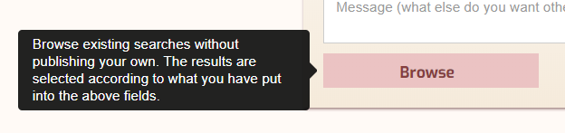
User-friendly Design
Logical and intuitive task flow
Function grouping
Multiple entries
Help messages
Tooltips
Page Titles
Notes:
The style of our website is warm and joyful. We incorporated soothing colours and cheerful messages to encourage sharing and supporting. The section titles like Quest has a game-like feel.

Slide 13
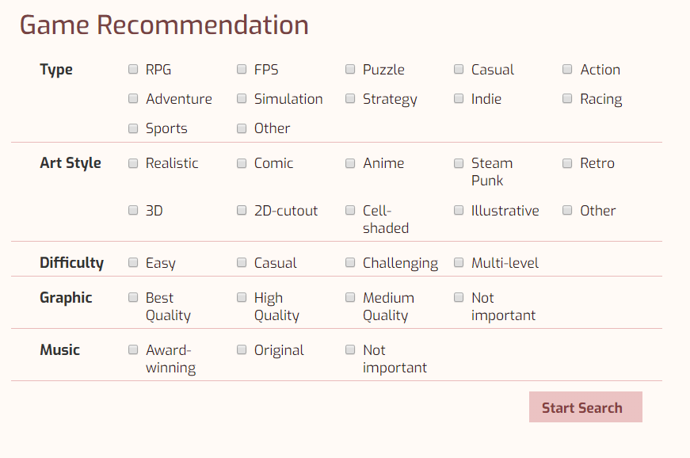
Truly Care About Female Gamers
Search Option design
Based on female-preferred game traits
Notes:
As shown earlier, the categorical search function was our users’ favorite.
The options are designed according to female preferred game traits, and we hope that this can help female gamers find their desired games in a world full of male-targeting advertisements.

Slide 14
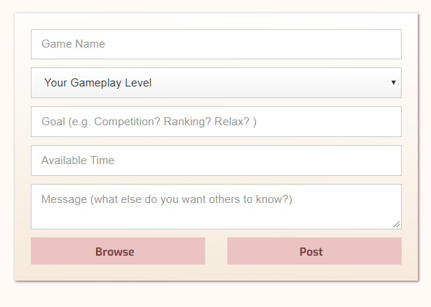
Truly Care About Female Gamers
Teammate Search
Meet new friends with similar gaming goals
Notes:
The teammate search function was meant to help users meet new friends who have similar gaming goals.

Slide 15
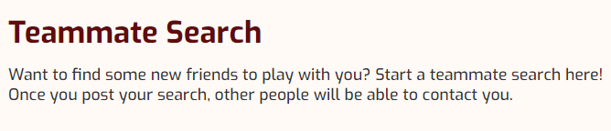
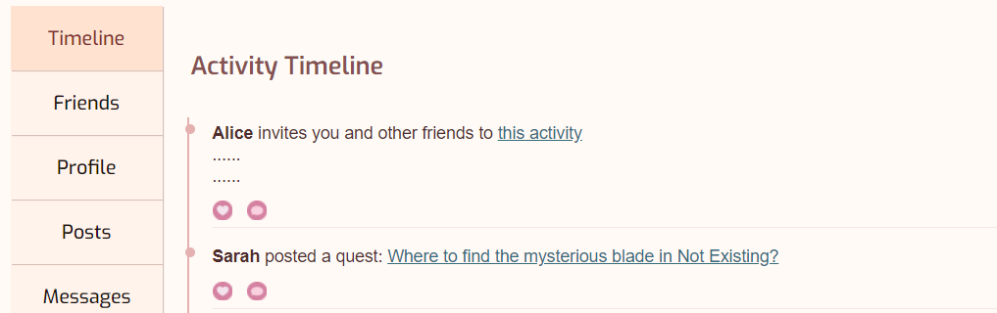
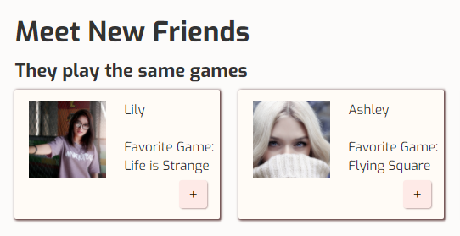
Various Social Functions
The sense of belonging
Focused social network
Niche Market
Notes:
We have various social functions to provide users with the sense of belonging. Our female gamers do not need to worry about hiding their gender here.

Slide 16
The Process
Notes:
So,how exactly did we go from the very beginning to our final product?

Slide 17
Problem Space Research
Literature Review
5
Articles
Questionnaire
61
Participants
Interview
5
Female Participants
Observation
5
Female Participants
Notes:
Well you know. Gender-inequality is really a big big topic. We have to break the problem space into smaller parts, the specific problems that we need to solve. That is why the problem space research is our first step.
We reviewed 5 articles, distributed questionnaires to 61 participants, conducted 5 interviews and 5 observation studies. our studies covered almost every aspect of female gamers’ gaming experience.

Slide 18
User Needs
Gaming Community
Friendliness
The sense of belonging
Support
Female-Preferred Game Traits
Artistic graphics
Enjoyable gameplay mechanisms
Soundtracks
Easiness to play
Proposed Solution:
A Female-Oriented Gaming Community
Build connections among female gamers
Game recommendation tailored to personal tastes
Sharing and supporting
Friendliness
Notes:
After doing all this research, we identified two major components of user need. Female gamers want their community to be friendly and supportive. Also, females tend to care about certain game traits that are not typically advertised, like artistic graphics and enjoyable gameplay. That is why we proposed to build a gaming community that connect female gamers, recommend games tailored to their taste, and encourage sharing and supporting.

Slide 19
User Experience Research
Where are the opportunities | What should we present | Who are we targeting | How do users use our product
Experience Map | Design Requirements | 2 Key Personas | 3 Key Scenarios
Notes:
Since now we had our goal. How can we make it come true? Firstly, we designed an experience map to identify where our opportunities were. Then we came up with lots of design requirements to layout what we should present. Then we designed 2 key personas to understand who we were targeting and 3 key scenarios to guide our function design and usability testing in later phases.

Slide 20
Prototype Evolution
Real user usability testing
Euforia 2.1
Polished styling
Added additional entries to core functions
In-class usability testing
Euforia 2.0
Adjusted website layout
Simplifed button description
Added more tooltips
Paper Prototypes
Heuristic Evaluation
Euforia 1.1
Corrected the most obvious problems
Euforia 1.0
Combined individual prototypes
Notes:
So begin with our paper prototypes. Eachof our group members individually designed a page prototypers. Combined them together,the first Euforia was born. Later on, we did heuristic evalution which I identified and corrected most obious problems.

Slide 21
Back to The Big Picture

Slide 22
Our Ideals (We have a dream)
Our female-oriented design will attract female gamers
Our users will feel supported in our community
Our users will share their knowledge and help others
The whole community will grow into an influencing organization
…… And our dream of a better gaming world will come true

Slide 23
Thank You

